Slide 1
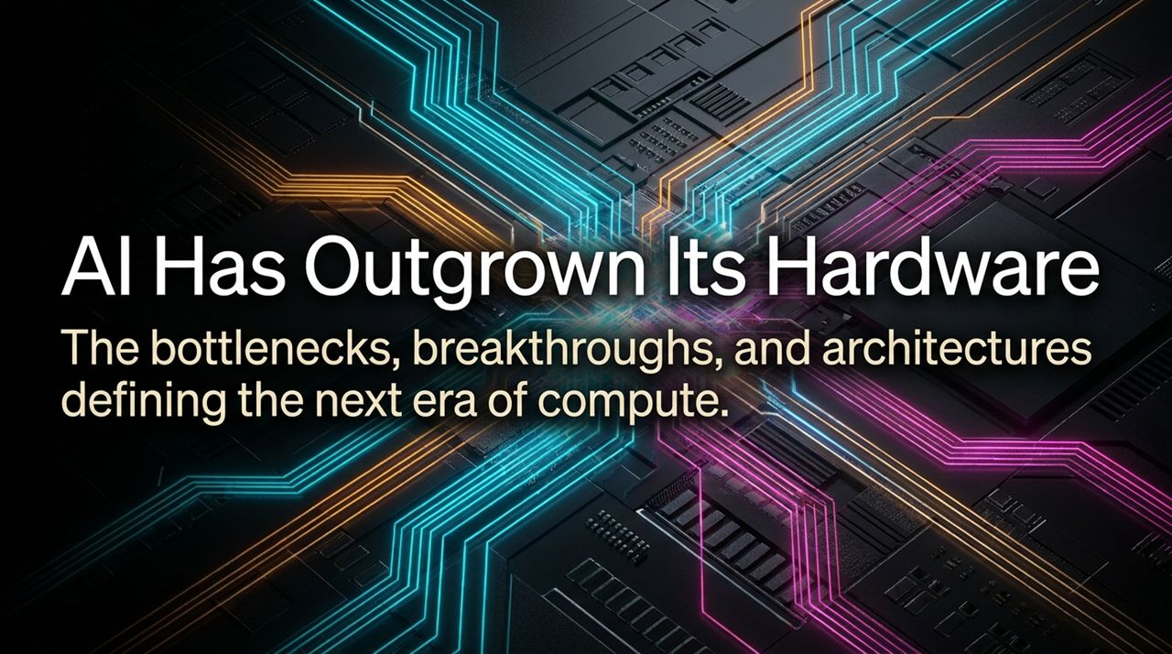
Notes:
Intro & Core Hook: Welcome, everyone. Today, we're addressing a structural crisis occurring at the foundation of modern technology. Every headline right now is focused on large language models and frontier AI capabilities[cite: 4]. However, while software is advancing at an exponential pace, the underlying silicon executing these models is hitting a hard physical wall.
The Disconnect: As discussed in recent industry discussions—notably by Andrew Feldman and Atiq Raza—we are running today's most brilliant multi-billion-parameter neural networks on yesterday's repurposed video game chips. The legacy GPU architecture, designed originally for parallel graphics rendering, was never engineered for the continuous memory-fetching and token-generation demands of modern AI inference.
Session Roadmap: Over the next 13 slides, we will break down the hardware bottlenecks holding AI back, explore the three core pillars of computer architecture, analyze how software quantization is reacting to hardware starvation, and look at purpose-built architectures—like wafer-scale compute and optical photonics—that define the next era of compute.
https://www.youtube.com/watch?v=t_zMMjjIjFc

Slide 2
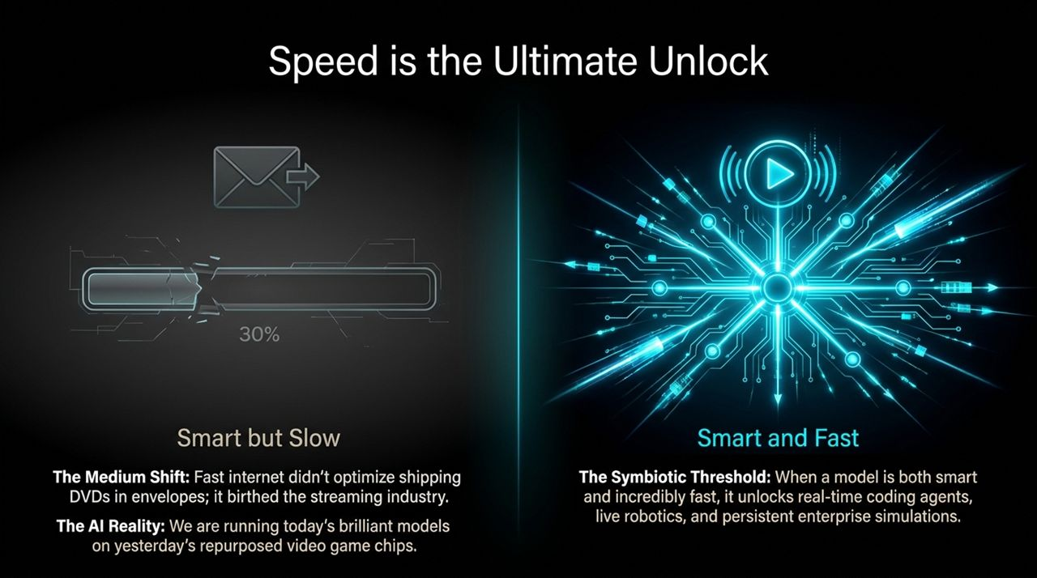
Notes:
The Medium Shift Analogy: To understand why speed is so critical, let's look back at historical platform shifts. When broadband internet arrived in the late 1990s and early 2000s, fast connection speeds didn't just optimize the existing business model of shipping Netflix DVDs in red envelopes. Instead, it completely destroyed that paradigm and birthed the streaming industry.
Smart but Slow (The 30% Bottleneck): Right now, we are in the 'DVD-by-mail' era of AI. Our models are undeniably smart, but they are painfully slow. If an AI coding agent takes several minutes to analyze a pull request or an enterprise agent takes eight minutes to perform a workflow, a human will simply do it manually. Speed is not just a convenience; speed is productivity.
The Symbiotic Threshold: When we cross the threshold where AI models become both highly intelligent and extraordinarily fast (e.g., 10x to 100x current inference speeds), an entirely new category of software unlocks. We move from static text chatbots to real-time coding agents, live robotics feedback loops, and continuous enterprise simulations.

Slide 3
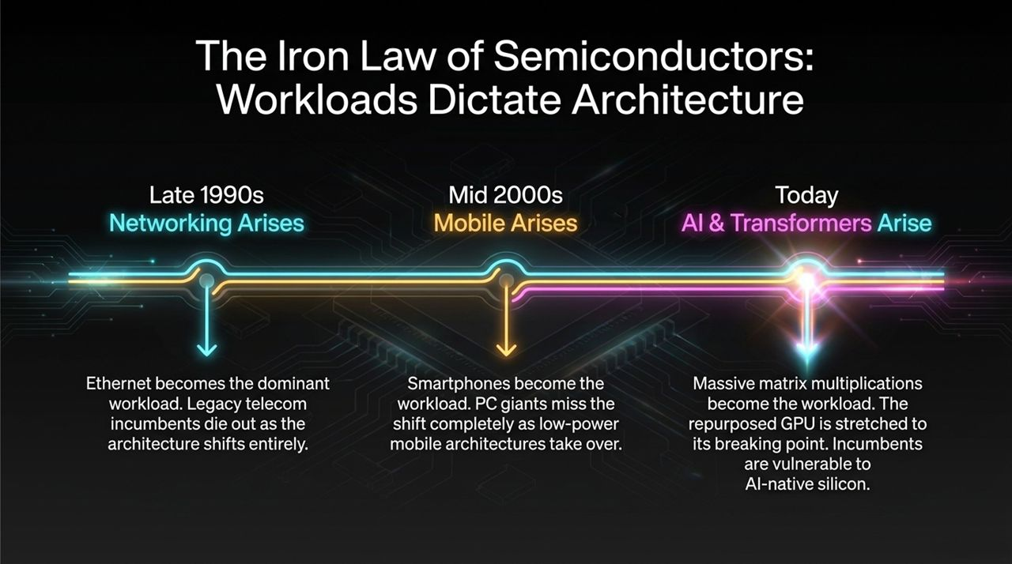
Notes:
Historical Context (1990s): In semiconductors, there is an immutable rule: Workloads dictate architecture. Whenever a dominant new workload arises, market incumbents who refuse to change their core architecture get replaced. Look at the late 1990s: Ethernet networking became the dominant workload. Legacy telecom giants with legacy hardware architectures lost their dominant market position to ASIC-driven packet switching.
Mobile Shift (2000s): In the mid-2000s, smartphones emerged. Wintel and PC giants tried to push high-power x86 chips into mobile, missing the fundamental shift to low-power ARM architectures.
The Transformer Shift (Today): Today, massive matrix multiplications and attention mechanisms are the workload. Graphics Processing Units (GPUs) were a brilliant bridge for early deep learning training, but today they are being stretched to their absolute physical limits. As workload demands evolve from simple training to multi-stage agentic inference, repurposed GPUs are vulnerable to purpose-built, AI-native silicon.

Slide 4
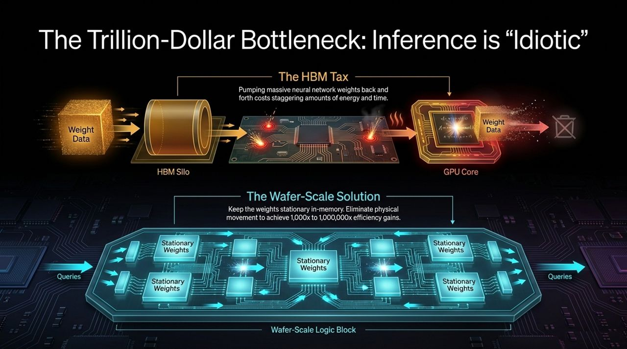
Notes:
The Idiotic Energy Gap: Panelist Dave pointed out a glaring inefficiency in modern AI inference: what we do right now in inference is utterly idiotic. During inference, neural network weights remain fixed, yet traditional GPU clusters spend staggering amounts of electrical energy repeatedly pumping massive model weights back and forth from High Bandwidth Memory (HBM) into compute cores.
The Memory Wall / HBM Tax: A GPU core processes a weight in picoseconds, but fetching that weight across copper traces on a board takes hundreds of times longer and consumes orders of magnitude more energy. We are wasting precious power simply moving data across millimeters of distance rather than performing math.
The Wafer-Scale Solution: The architectural solution is to eliminate the physical movement of data entirely. By using wafer-scale integration—keeping the entire model's weights stationary in SRAM across an entire silicon wafer—you feed queries directly through stationary weights. This eliminates off-chip HBM bottlenecks and yields 1,000x to 1,000,000x improvements in operational energy efficiency.

Slide 5
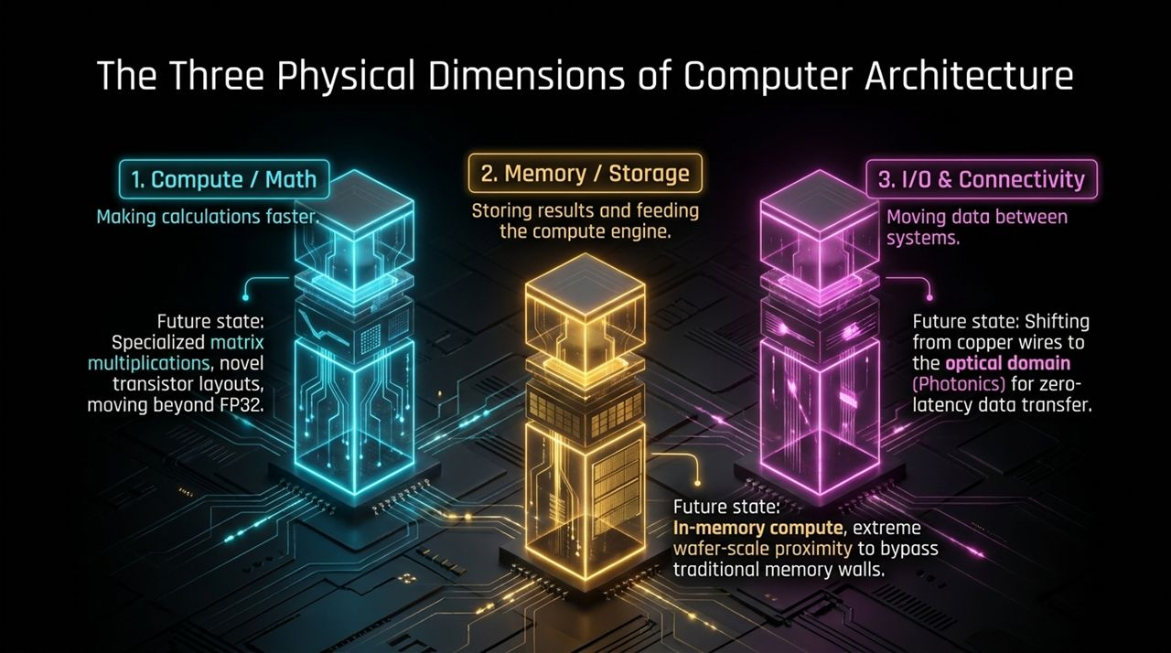
Notes:
Simplified Framework: As Atiq Raza and Andrew Feldman highlighted, every innovation in the 70-year history of computer engineering reduces to just three physical dimensions: Compute, Memory, and I/O.
Pillar 1 — Compute / Math: This is about making raw calculations faster. The future here involves specialized matrix-multiply blocks, low-precision number formats, and novel transistor arrangements.
Pillar 2 — Memory / Storage: This focuses on storing weights/activations and feeding them to the compute engine. The future lies in in-memory compute and extreme wafer-scale proximity to bypass the traditional von Neumann memory wall.
Pillar 3 — I/O & Connectivity: This governs moving data between processors and nodes. We are hitting the physical limits of copper wiring. The future state shifts data transmission into the optical domain using Silicon Photonics for high-bandwidth, near-zero-latency interconnects.

Slide 6
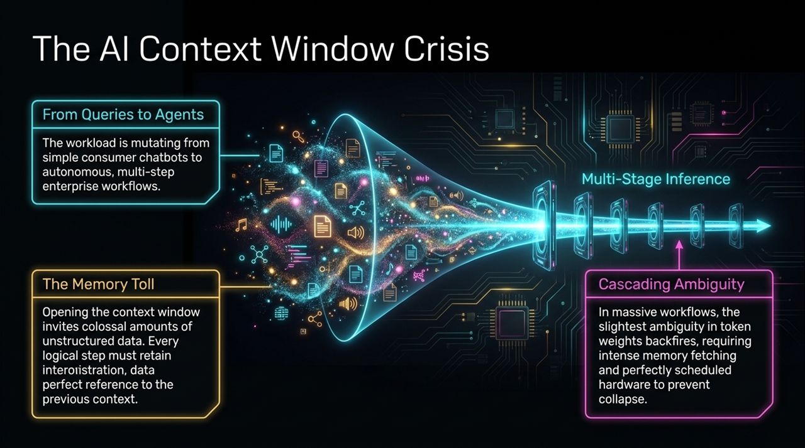
Notes:
Workload Mutation: The compute problem is compounding because the AI workload itself is mutating. We are moving away from single-prompt consumer queries (like 'Write a poem') toward autonomous, multi-step enterprise agent workflows.
Expanding Context Windows: To enable enterprise agents, models now support context windows of 1M to 2M+ tokens. Opening up the context window acts as an open invitation to suck in massive amounts of unstructured enterprise data.
The Memory & Ambiguity Toll: Unlike single-stage generation, multi-stage agentic inference requires every single execution step to retain exact memory references to the prior context. Any minor ambiguity in token weight assignment or KV-cache management cascades through the workflow. This creates an extraordinarily memory-intensive workload that causes legacy GPU memory systems to collapse under severe data starvation.

Slide 7
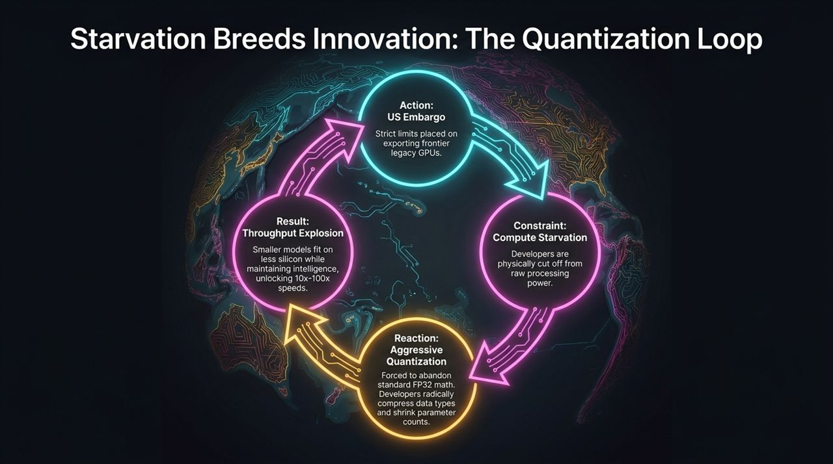
Notes:
Geopolitical Constraints: When hardware is constrained, software engineers are forced to innovate aggressively. A prime example of this loop occurred when US export controls restricted frontier hardware access in certain overseas markets.
The Reaction (Quantization): Cut off from raw compute scaling, developers abandoned standard FP32 floating-point math. Instead, they focused heavily on extreme quantization (FP8, INT4, FP4) and parameter compression.
The Result: The outcome was surprising: by aggressively reducing data precision and parameter overhead, developers created compact models that perform at parity with massive frontier benchmarks. Because these quantized models fit entirely within on-chip SRAM memory, they achieved a 10x to 100x explosion in inference throughput.

Slide 8
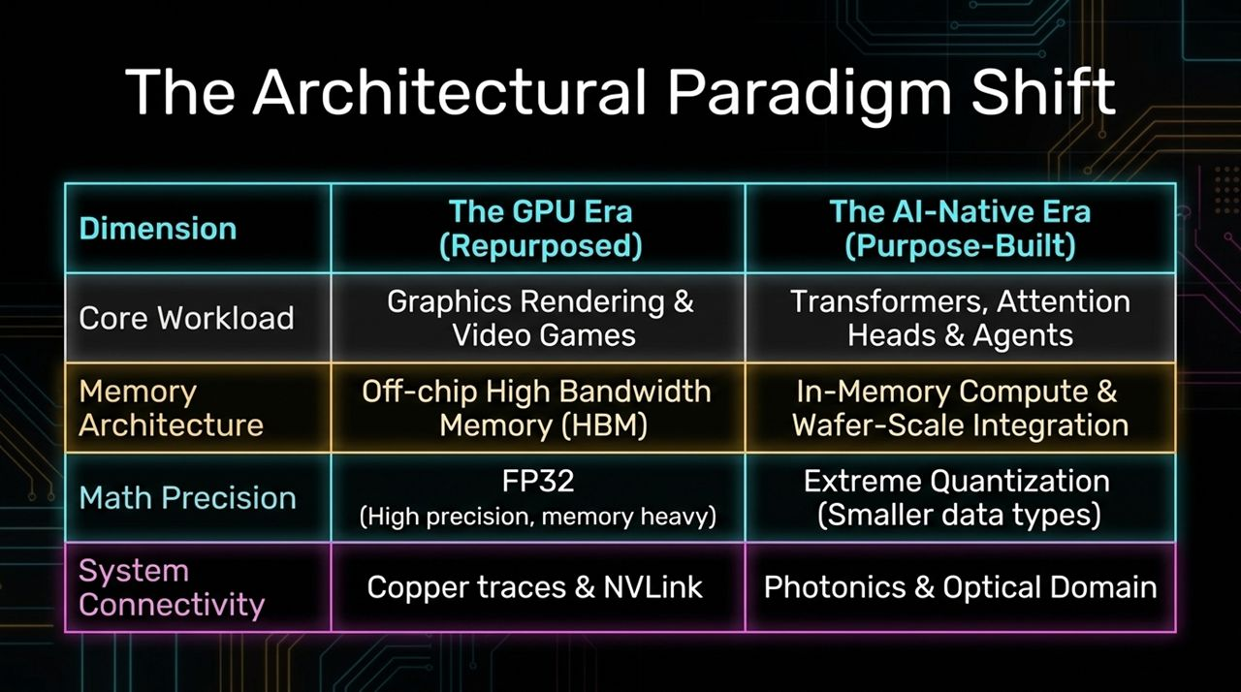
Notes:
Comparing Eras: Let's formalize the transition between the two eras.
Workload: The GPU era optimized for rasterization, 3D graphics, and floating-point geometry. The AI-Native era optimizes exclusively for Transformers, attention heads, matrix math, and agentic reasoning loops.
Memory & Precision: The legacy era relies on off-chip High Bandwidth Memory (HBM) using high-precision FP32/FP16 formats. The AI-native era uses In-Memory Compute, Wafer-Scale integration, and extreme quantization formats.
Interconnect: Legacy systems rely on copper traces on PCBs and standard NVLink channels. Next-generation AI systems are transitioning directly to photonics and optical domain connectivity.

Slide 9
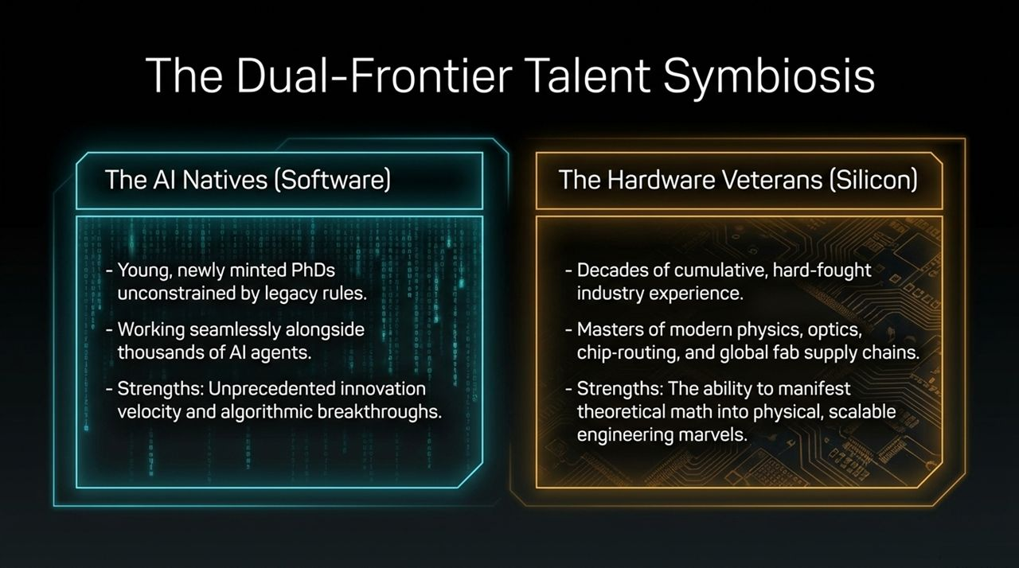
Notes:
The AI Natives: Building in this era requires a unique synthesis of talent. On one hand, we have newly minted PhDs graduating from universities who are AI-native. They don't write low-level code line-by-line; they manage fleets of AI agents to write, test, and optimize software at unprecedented velocity.
The Hardware Veterans: On the other hand, AI software alone cannot bypass the physical laws of thermodynamics, optics, and chip fab yields. This requires silicon veterans with decades of hard-fought engineering experience in chip layout, signal integrity, power delivery, and global fab supply chains.
The Symbiosis: Winning hardware companies are built on the collaboration between unconstrained young software talent and battle-tested silicon architects.

Slide 10
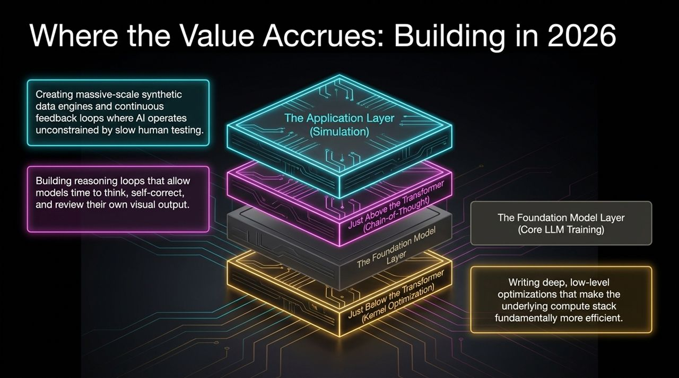
Notes:
Where Value Sits: Where is venture capital and engineering value accruing across the stack today?
Below the Transformer: Deep low-level kernel optimizations (e.g., custom CUDA/SRAM kernels) that squeeze 2x to 10x more throughput out of existing silicon stacks.
Above the Transformer: Chain-of-thought reasoning loops. Giving models runtime to think, self-correct, and review their outputs before returning a token yields exponential jumps in intelligence without changing underlying base weights.
The Application Layer (Simulation): Building continuous simulation engines. Instead of bottlenecking AI development with slow real-world human testing, top platforms build synthetic data feedback loops and digital twin environments where models iterate at compute speed.

Slide 11
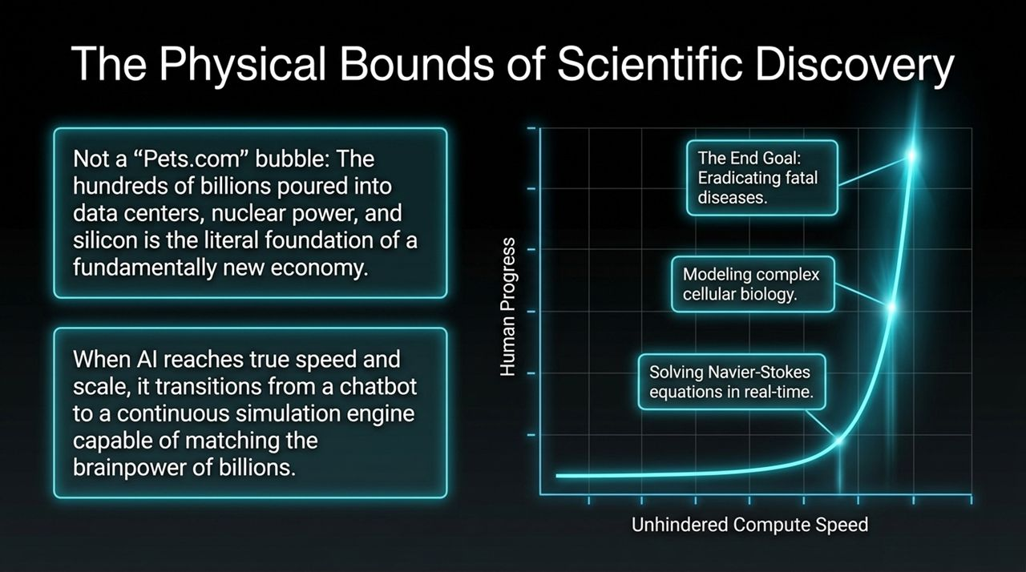
Notes:
Debunking the Bubble Thesis: Critics often compare current data center, nuclear power, and silicon capital expenditures to the 2000 Dot-Com / Pets.com bubble. That comparison misses the broader picture. The capital flowing into AI infrastructure is building the physical foundation for a new global economy.
Transitioning to Simulation Engines: When compute speed is unhindered by memory bottlenecks, AI transitions from a text chatbot into a real-time scientific simulation engine.
Real-World Impact: We move from simple text generation to solving real-time Navier-Stokes fluid dynamics equations, modeling cellular biology, and simulating complex molecular interactions to discover targeted cancer cures.

Slide 12
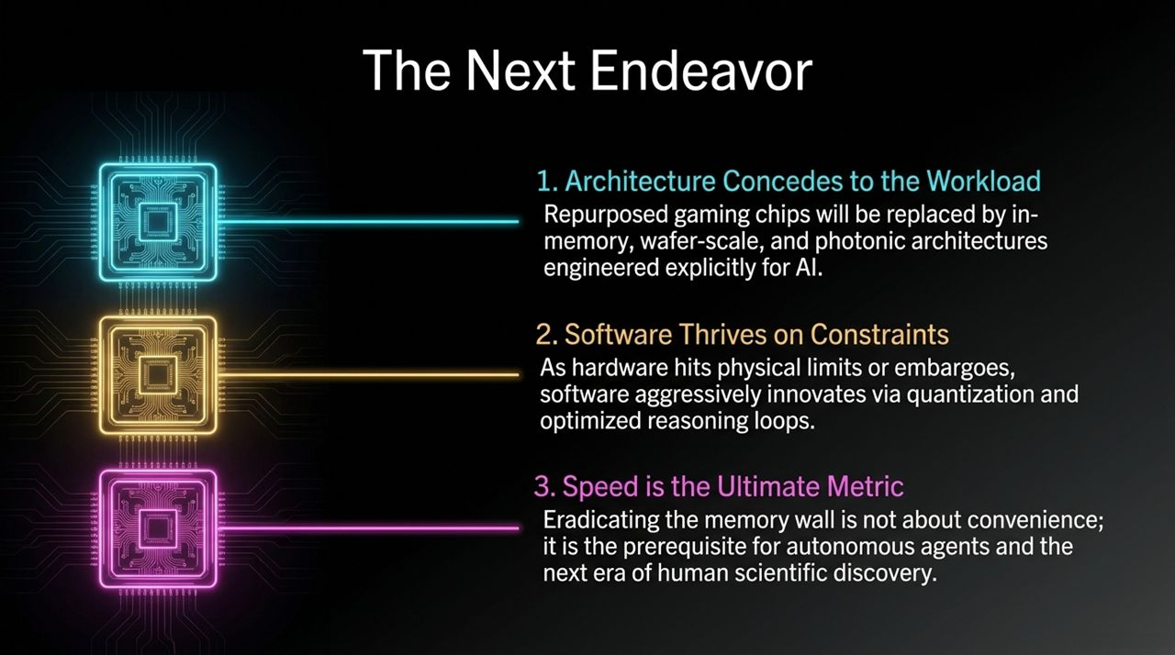
Notes:
Takeaway 1 — Architecture Concedes to Workload: Repurposed gaming chips have reached their structural limit. The future belongs to purpose-built, wafer-scale, in-memory, and photonic architectures engineered explicitly for AI.
Takeaway 2 — Software Thrives on Constraints: As physical chip limits and supply chains face friction, software adapts through quantization, low-precision math, and runtime reasoning loops.
Takeaway 3 — Speed is the Ultimate Metric: Eradicating the memory wall is not a minor feature update; it is the core prerequisite for autonomous agentic workflows and scientific breakthroughs.

Slide 13
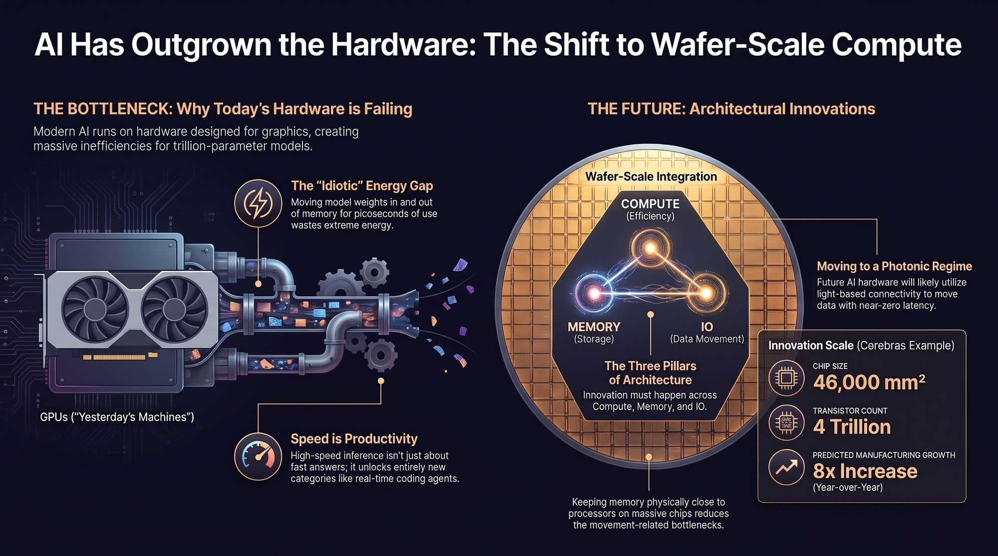
Notes:
Case Study — Cerebras Wafer-Scale Engine: To conclude, let's examine what purpose-built AI hardware looks like in production today. Cerebras built a single monolithic chip measuring 46,000 square millimeters, containing 4 trillion transistors and entirely on-chip SRAM.
Solving the Bottleneck: By keeping memory and compute on a single piece of silicon wafer, they completely eliminate the energy-hungry HBM bus. They are scaling manufacturing by 8x year-over-year to meet gigawatt-scale data center demand.
The Final Frontier: As we look ahead, integrating wafer-scale in-memory compute with optical photonics interconnects will usher in an era of unhindered compute speed—enabling AI to solve the world's most complex challenges.
https://www.youtube.com/watch?v=t_zMMjjIjFc

